Slide 1
Photomicrographs of Plant foods
Dill
Permission to reproduce original photomicrographs used to make this collection may be obtained from
Dr. David O. Norris at
david.norris@colorado.edu

Slide 2
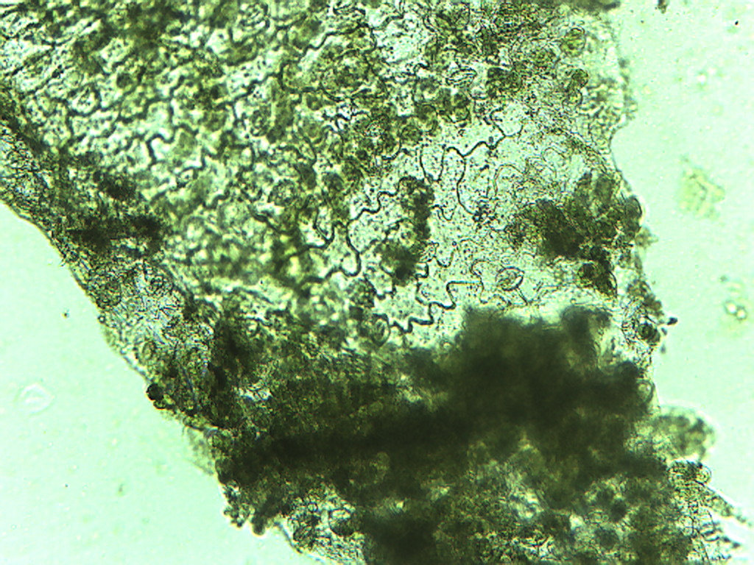
Notes:
163. Anethum graveolens Dill. Leaf epidermis, 10X.

Slide 3
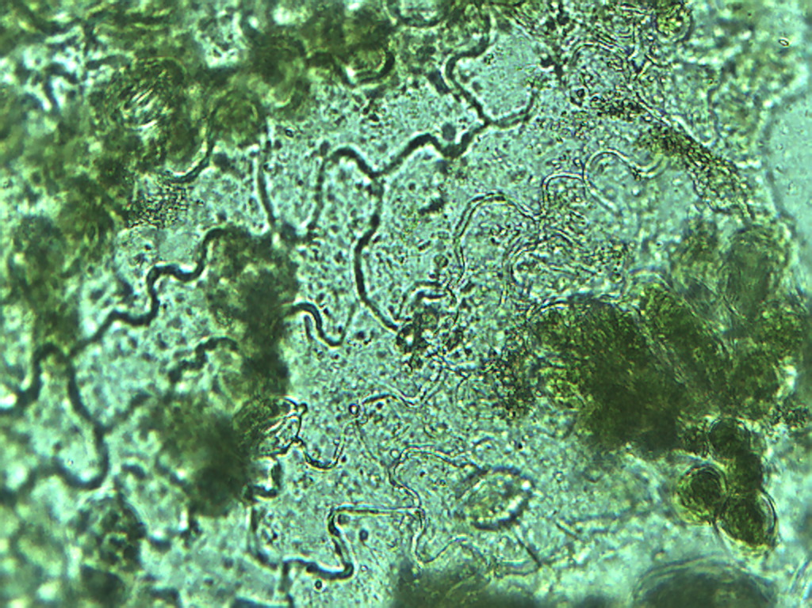
Notes:
164. Dill. Leaf epidermal cells, 25X.

Slide 4
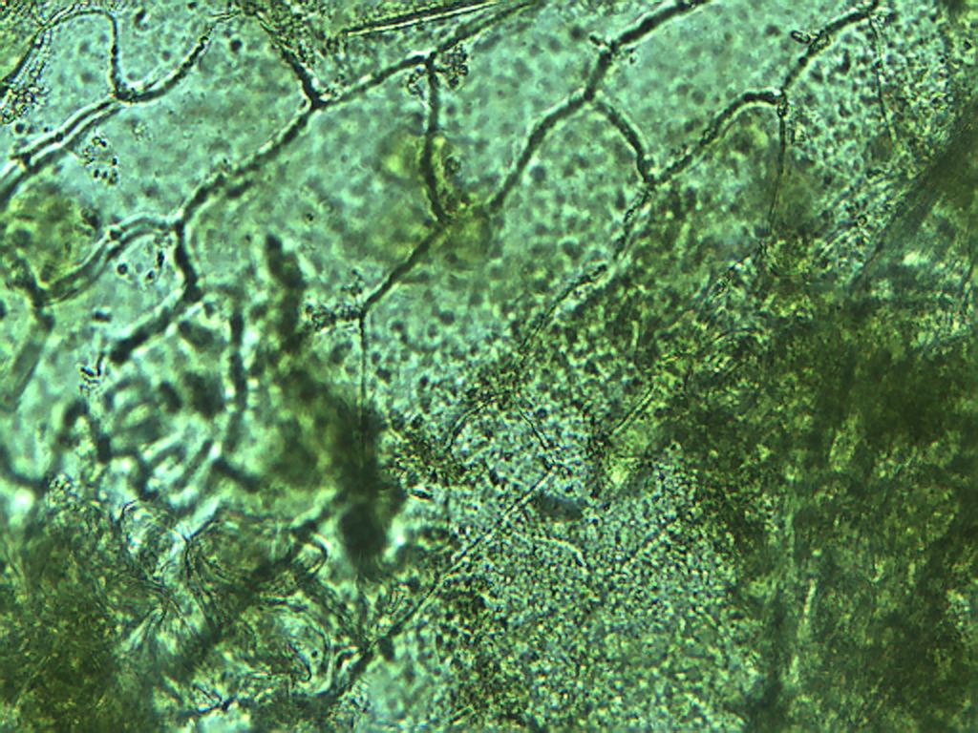
Notes:
165. Dill. Leaf epidermal cells, 25X. Compare with jig-saw puzzle piece-shaped cells also found in the epidermis.

Slide 5
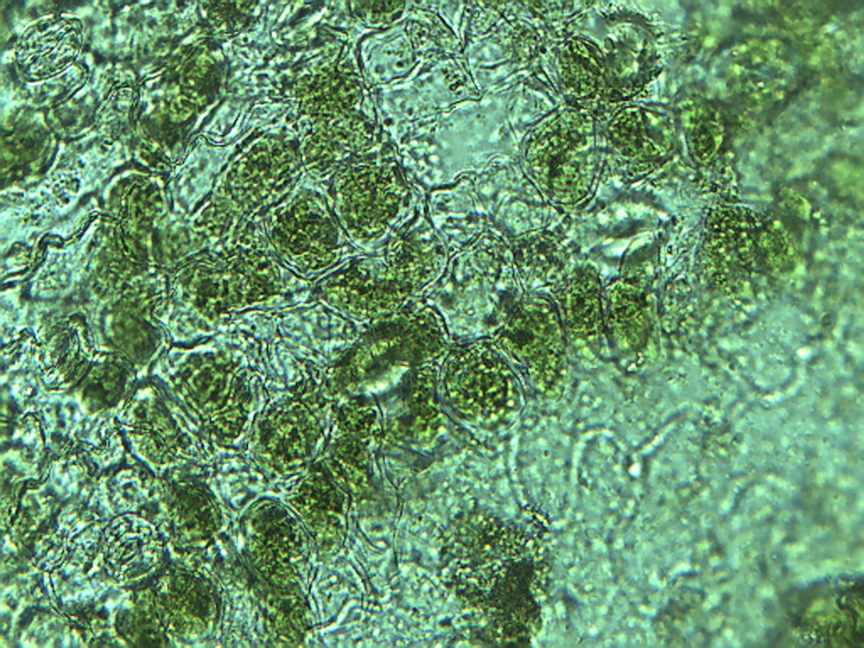
Notes:
166. Dill. Leaf epidermis underside with photosynthetic parenchyma containing green chloroplasts (arrows), 25X.

Slide 6
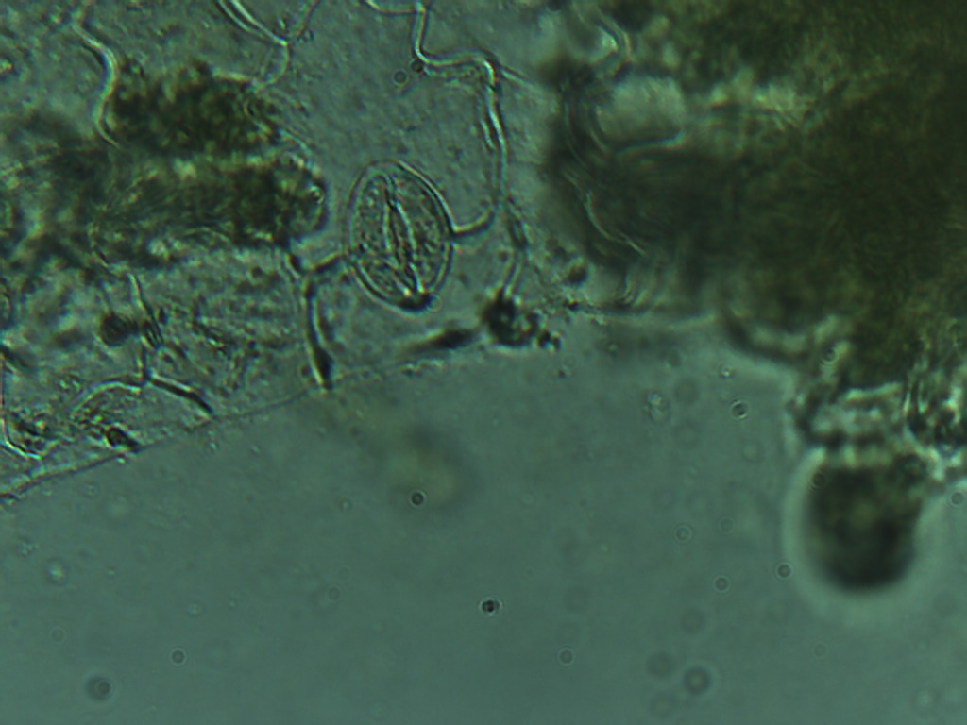
Notes:
167. Dill. Leaf epidermal stomate (arrow), 40X.

Slide 7
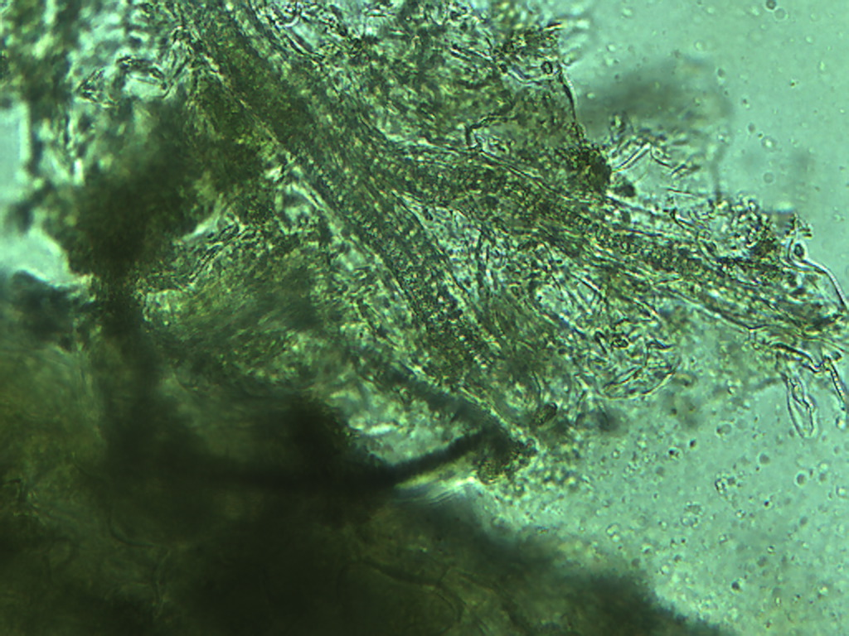
Notes:
168. Dill; vascular tissue, 25X

Slide 8
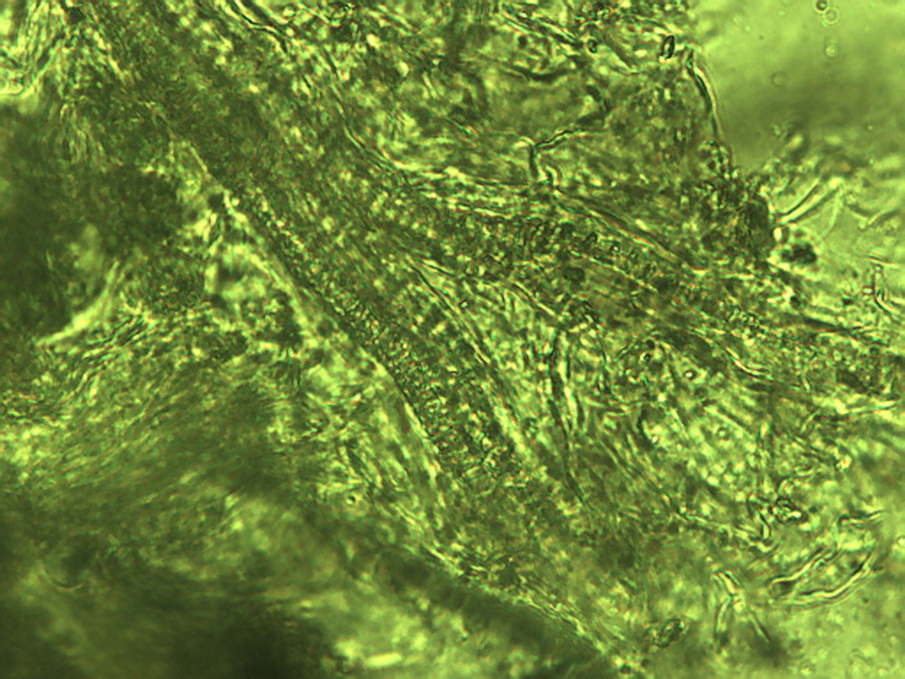
Notes:
169. Dill; vascular tissue, 40X

